Slide 1
Langchain Fundamentals and Use Cases

Slide 2
Langchain components
LLMs Models
The interface to the AI brains
Memory
Prompts
Remember previous conversation
Pre-made prompt templates and workflows
Indexes
COMPONENTS
Store and structure data
Tools & Chains
LLM + prompt
Schema
Agents
Nuts and Bolts of working with LLMs
Integration with external tools and chains

Slide 3
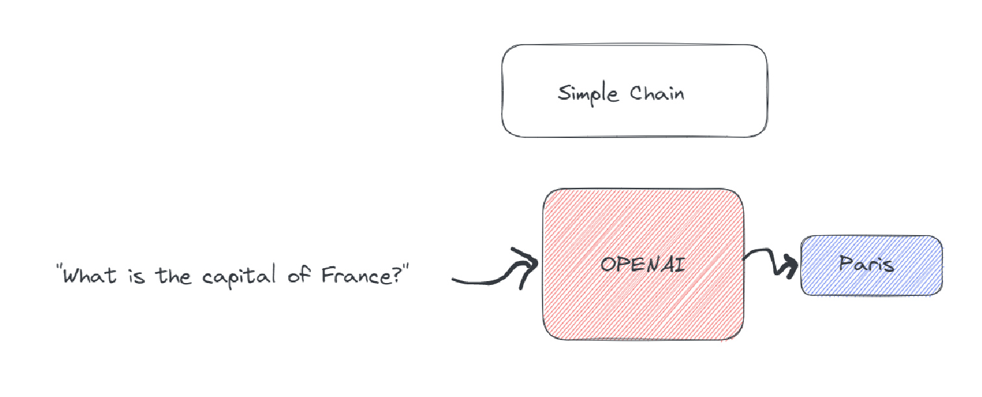
Simple chain

Slide 4
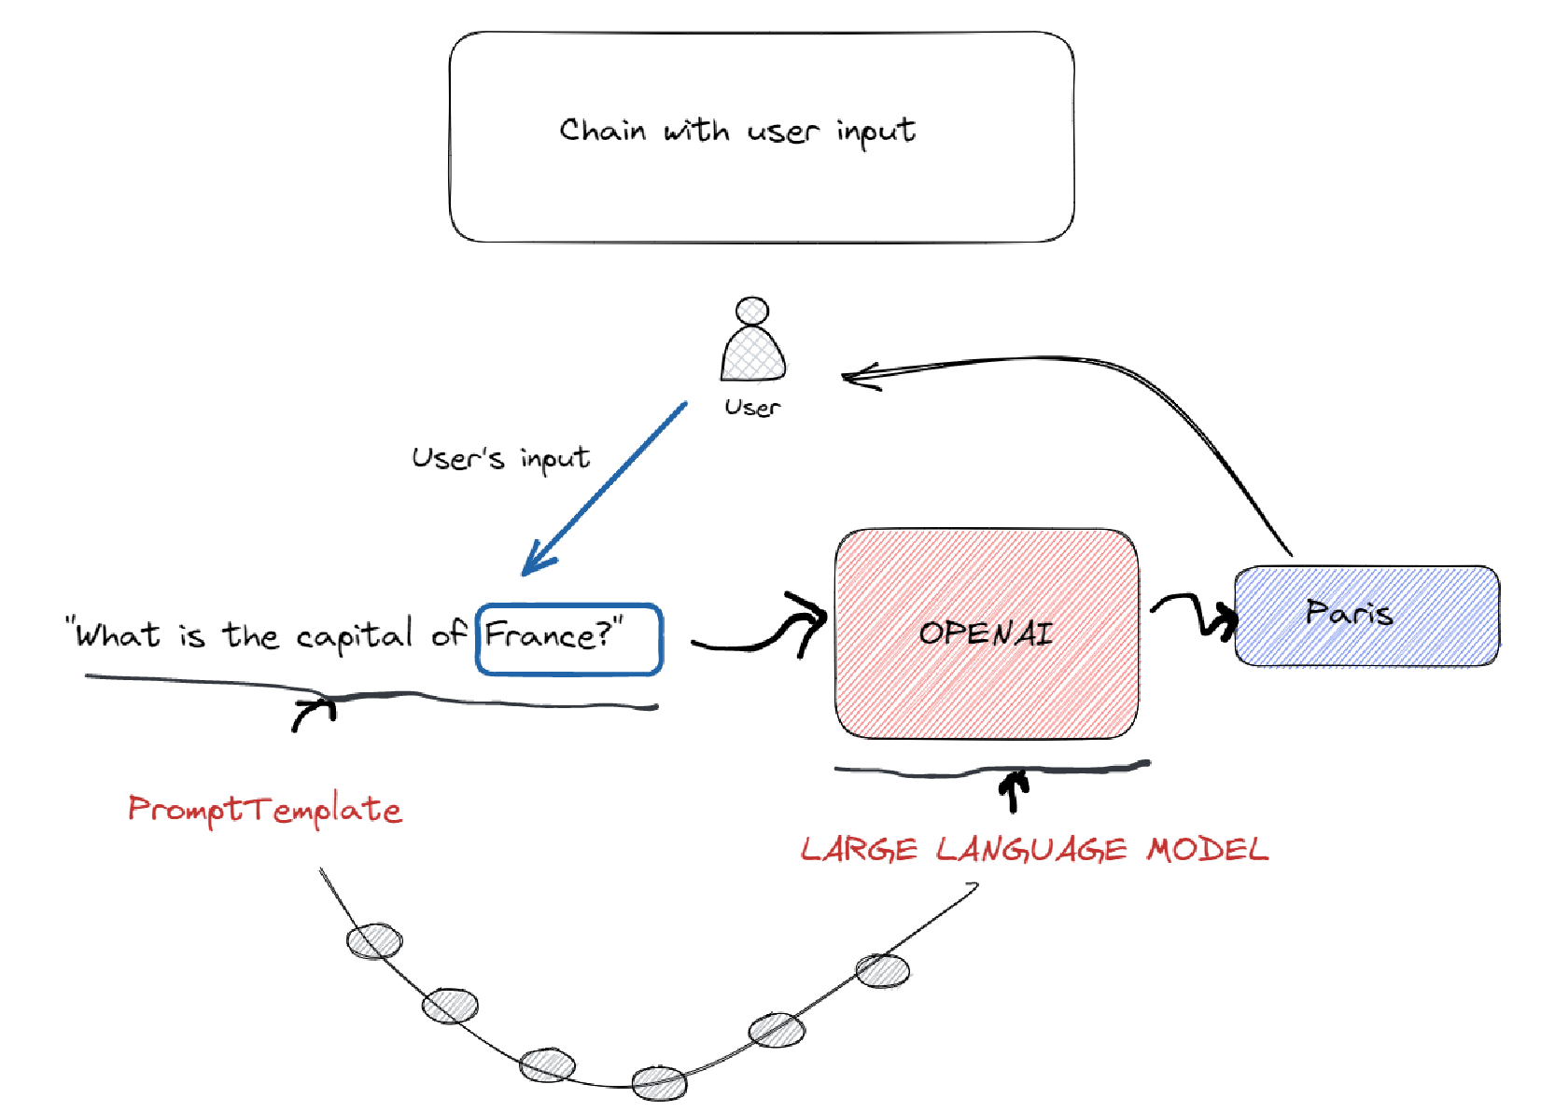
Simple chain

Slide 5
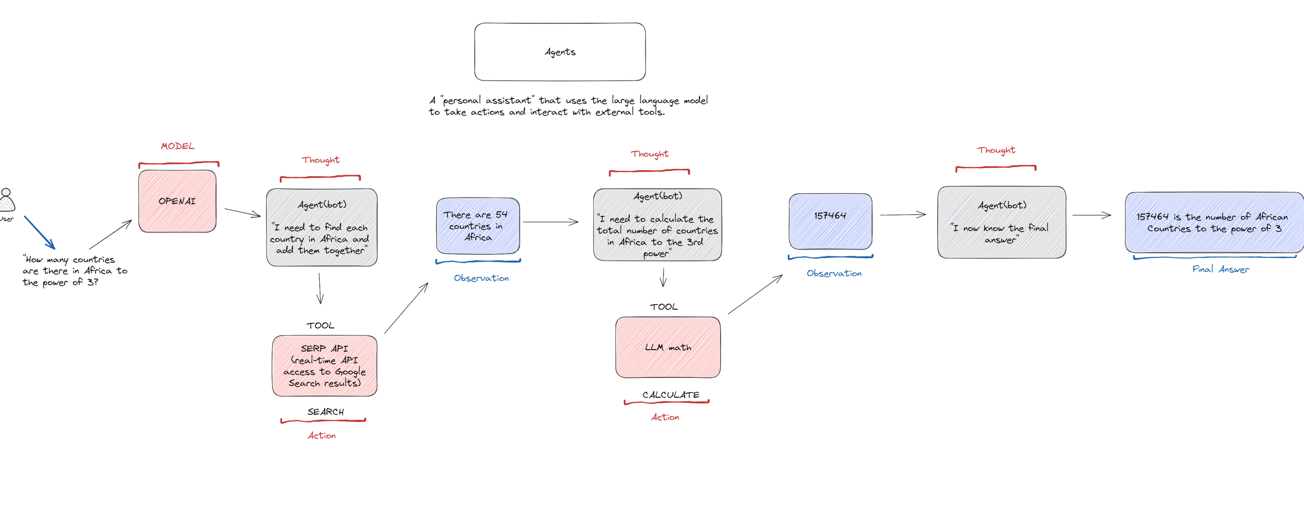
Agents

Slide 6
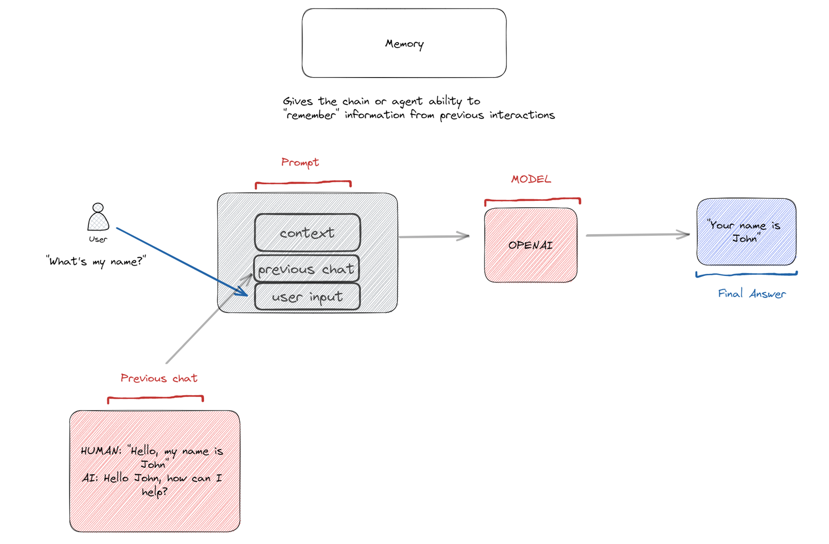
Memory

Slide 7
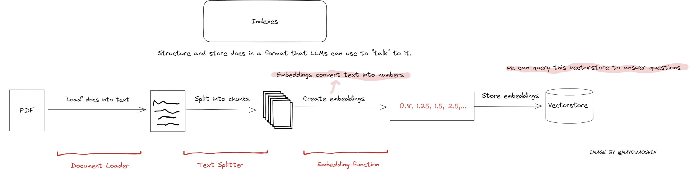
Simple chain

Slide 8
Demo – Langchain Fundamentals

